Slide 1

CSCI 476: Computer Security
Review + Lessons Learned
Reese Pearsall
Spring 2023
*all images are stolen from the internet
https://www.cs.montana.edu/pearsall/classes/spring2023/476/main.html

Slide 2
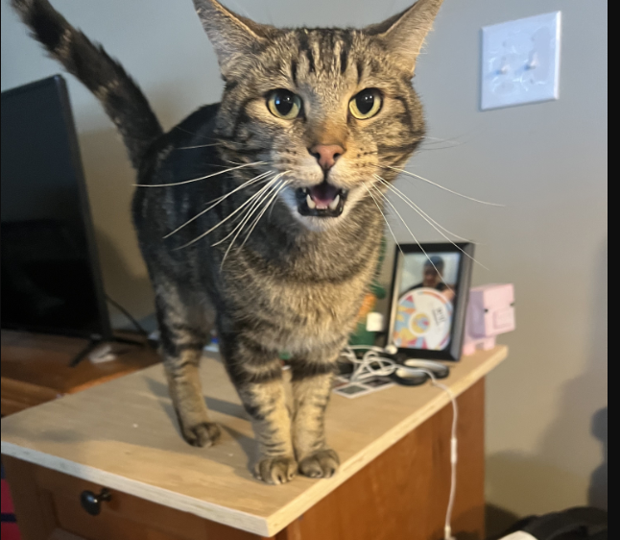
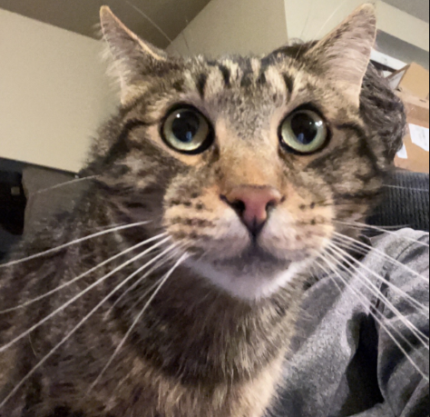
Announcements
Lab 10 due tonight
Fill out the course evaluation
Current Response Rate: 92%
Extra credit has been achieved!
Final Lab due on Wednesday May 10th at 11:59 PM
Project Grades have been posted
Meatball wishes you good luck on your final exams

Slide 3
CSCI 476 Timeline
January
February
March
April
Software Security | Web Security | Network Security | Cryptography
Look at a variety of attacks in the realm of software security, web security, network security, cryptography
→ Learn the countermeasures for these attacks (and how effective they are)

Slide 4

SET-UID Programs
A SET-UID Program allows a user to run a program with the program owner’s privilege
User runs a program w/ temporarily elevated privileges
Every process has two User IDs
Real UID (RUID)– Identifies the owner of the process
Effective UID (EUID)– Identifies current privilege of the process
If a program owner == root,
The program runs with root privileges
Methods of Attack
Unsafe Function Calls (system() vs exec() )
Overwriting important ENV variables (PATH)
Overwriting important linking ENV variables (LD PRELOAD)

Slide 5
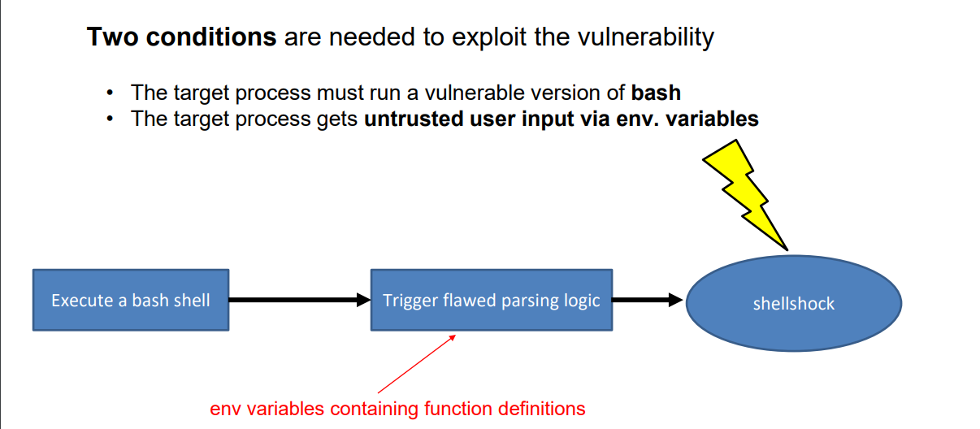
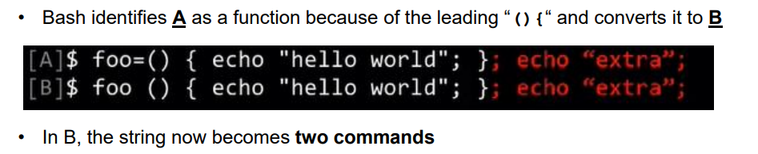
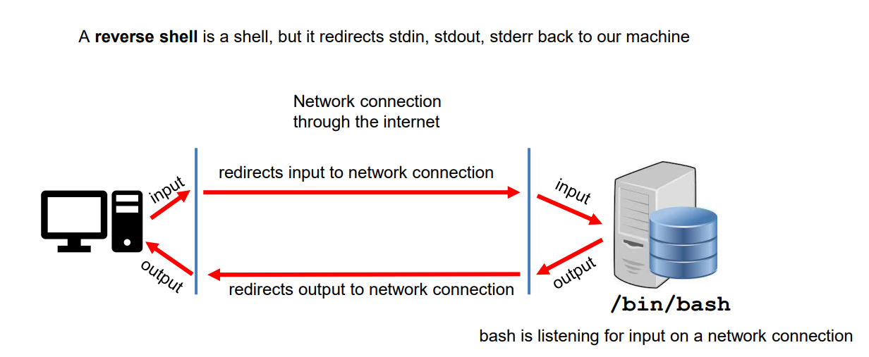
Shellshock Attack
Due to parsing logic in a vulnerable version of bash, we can export an environment variable that bash will interpret as a shell function
Example Payload

Slide 6
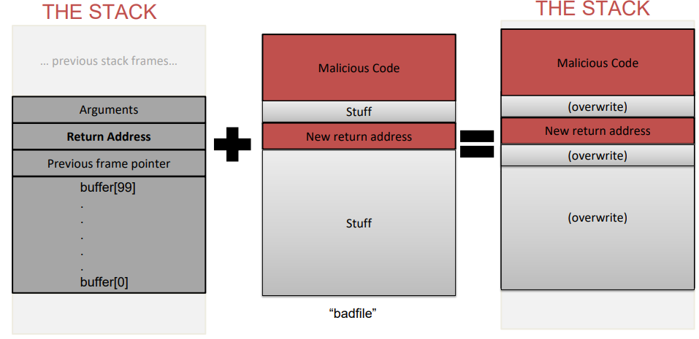
Buffer Overflow
When a program unsafely writes data to the stack via some buffer, we can overflow the buffer with our data
If we are smart, we can overwrite the return address and have the code jump to our malicious function
Countermeasures:
Secure Shell (/bin/dash)
ASLR
Stack Guard
Non-Executble Stack
To find the important locations in our stack, we used $ebp and $esp
The malicious code that we injected was shellcode
How did we bypass these countermeasures?
We filled overwrote everything else with NOPs

Slide 7
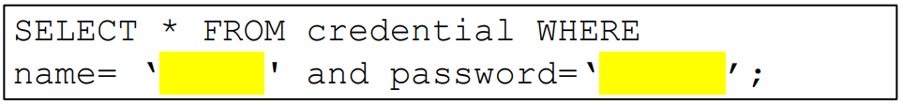
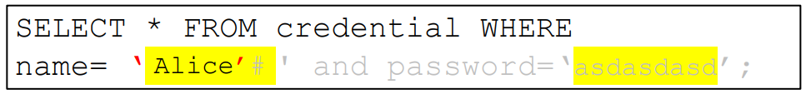
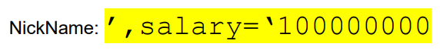
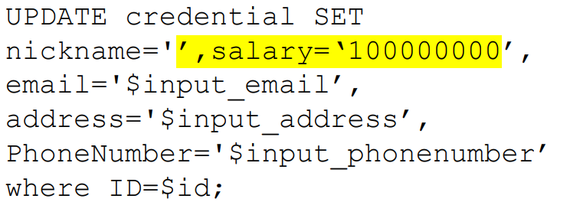
SQL Injection
It is common for user input to be inserted into a back-end SQL query. If an application is not careful about sanitizing user input, a user could supply an input that could be interpreted as SQL code and will interfere with the query
Username = Alice’#
Password = asdasdasd
Countermeasure: SQL Prepare() statements

Slide 8
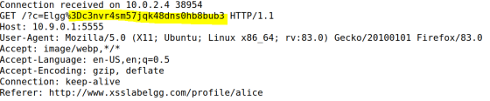
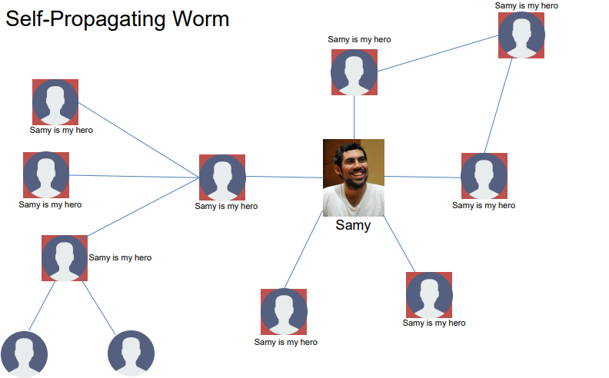

XSS Attack
Goal: Get someone else’s browser to execute our own JavaScript code
Vulnerability: Unsafe user input handling, and unsafe web communication policies
netcat server
Countermeasures:
Filtering
Encoding
CSP, CORS

Slide 9
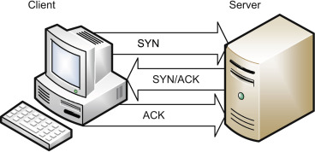
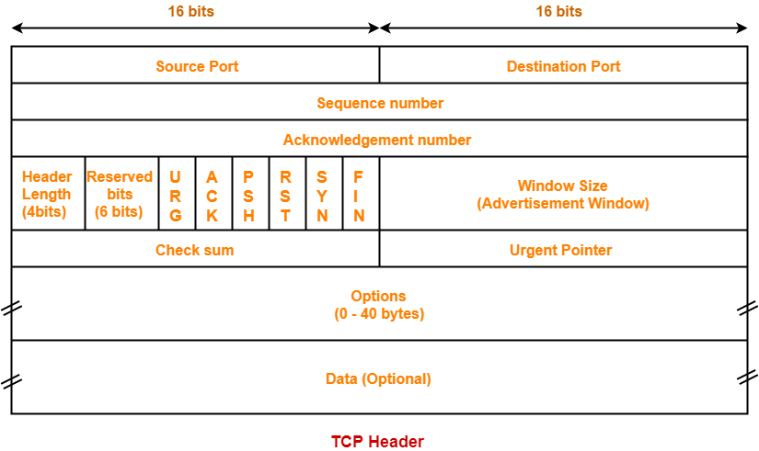


TCP Attacks
TCP Flooding- spoof a bunch of packets with bogus source IP addresses with the SYN flag. The server thinks these are legitimate requests and allocates computational resources for the request. We flood a server with these until the server can no longer accept new requests (and essentially denying service)
TCP Reset- Break an existing TCP connection by spoofing a TCP RST packet that looks like it came from one of the people in the existing TCP connection.
TCP Hijack- Hijack an existing TCP connection to get a TCP server to execute arbitrary commands. Spoofed a packet with the correct information so that the server thinks it came from the client

Slide 10






DNS Poisoning
A DNS cache poisoning attack is done by tricking a server into accepting malicious, spoofed DNS information
Instead of going to the IP address of the legitime website, they will go to the IP address that we place in our malicious DNS response (spoofed)
Internet
10.9.0.5
Client Container
10.9.0.53
Local DNS Server
Spoofed DNS
Response
Spoofed DNS
Response

Slide 11
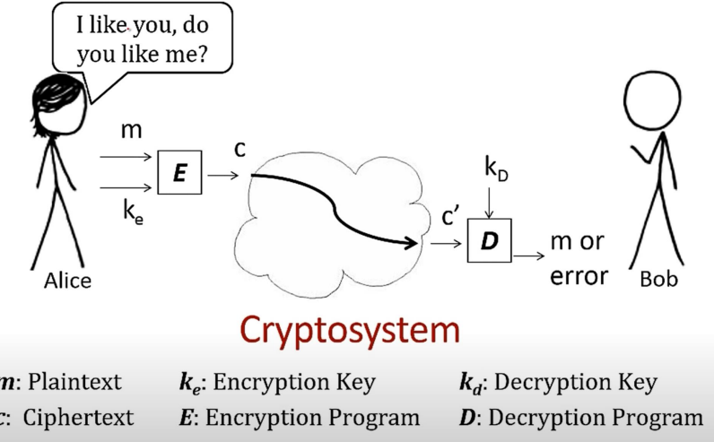

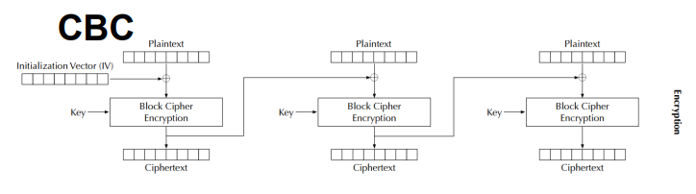
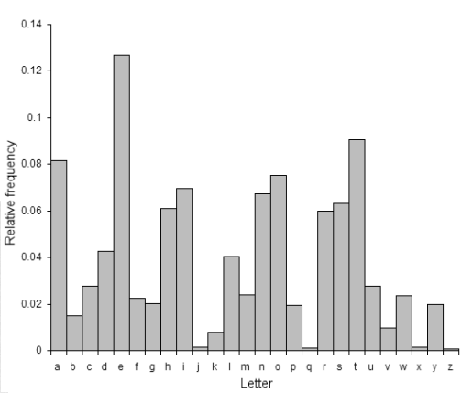
Symmetric Cryptography / Secret Key Encryption
Block Cipher (AES)
→ Split messages into fixed sized blocks, encrypt each block separately
Hello there world
01101000 01100101 01101100 01101100 01101111 00100000 01110100 01101000 01100101 01110010 01100101 00100000 01110111 01101111 01110010 01101100 01100100 00001010
Padding gets applied if the plaintext is not a multiple of the block size
Block 1
Block 2 Block 3
Frequency Analysis
(as a way to crack substitutions ciphers)
Ciphertext
An initialization vector (IV) is an arbitrary number that can be used with a secret key for data encryption
Modes of encryption: ECB, CBC, CFG, CTR, CFB

Slide 12
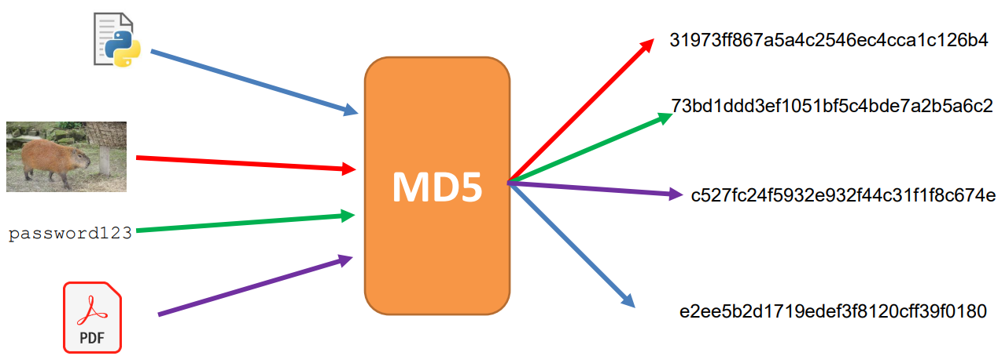
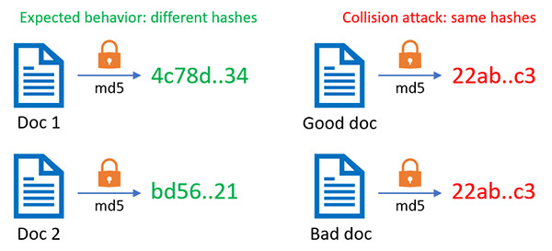
Hashing
Properties of Cryptographic Hash Function:
Given a hash, it should be difficult to reverse it
Given a message and it’s hash, it should be difficult to find another message that has the same hash
In general, difficult to calculate two values that have the same hash
Hash Collisions occur when two inputs map to the same hash, which can have some scary consequences
Applications of Hashing:
Message Integrity
Password Storing
Fairness and Commitment
Birthday Paradox

Slide 13
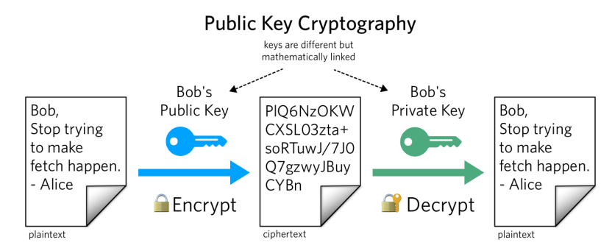
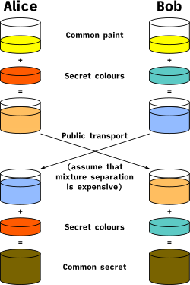
Asymmetric Cryptography / Public Key Encryption
Public Key vs Private Key (Mathematically linked)
Public key used to encrypt; Private key used to decrypt
Alice knows the prime products that generated her key, so it’s very easy for her to factorize
Eve does not know the products, and it is computationally infeasible for her to calculate the integer factorization of very large number
Diffie Helman Technique is used to transport a secret over an unsecure channel
RSA can not encrypt stuff that is larger than its key size,
So we typically will encrypt the key for a symmetric encryption algorithm (AES)
Private Keys are also used for digital signatures, which can be used to authenticate a message

Slide 14
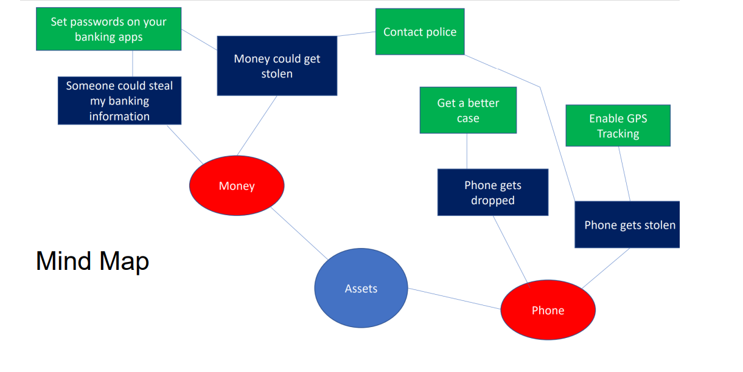
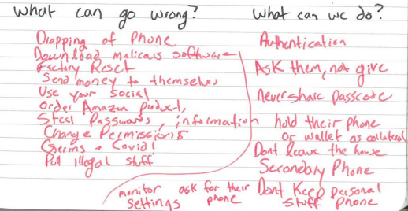
Threat Modeling
Threat modeling is a structured approach to assessing risk and defenses
What are you building?
What are the assets?
What can go wrong?
What should you do about those things that can go wrong?
Did you do a decent job of analysis?

Slide 15
CSCI 476 Course Outcomes
Understand important principles of security and threats to the CIA triad
Understand a variety of relevant vulnerabilities and defenses in software security (SETUID, Shellshock, Buffer Overflow)
Understand a variety of relevant vulnerabilities and defenses in network/web security (SQL Injection, XSS, TCP/IP attacks)
Understand a variety of relevant vulnerabilities and defenses in cryptography (Asymmetric, symmetric, One Way Hashing)
Given a system, develop a threat model, assess potential security weaknesses, and be able to think from the perspective of a threat actor
Make technical decisions during development of software with security in mind

Slide 16
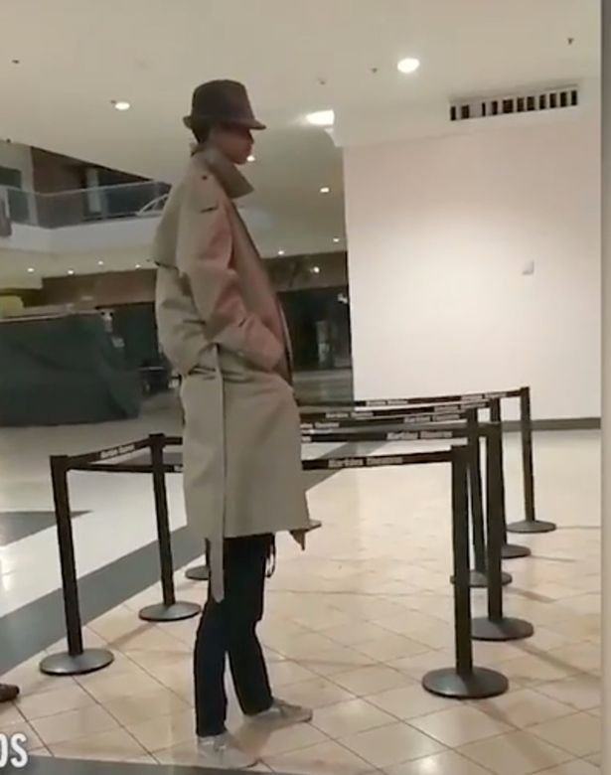


Takeaways
Trust- Trust as little as possible. We never know for sure how a user will interact with software

Slide 17
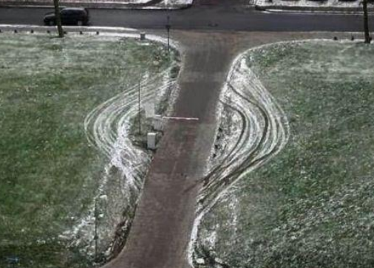
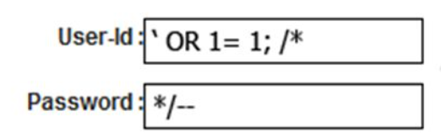
Takeaways
Trust- Trust as little as possible. We never know for sure how a user will interact with software
Intended Design- Users may interact with out system in ways that we did not think of.

Slide 18

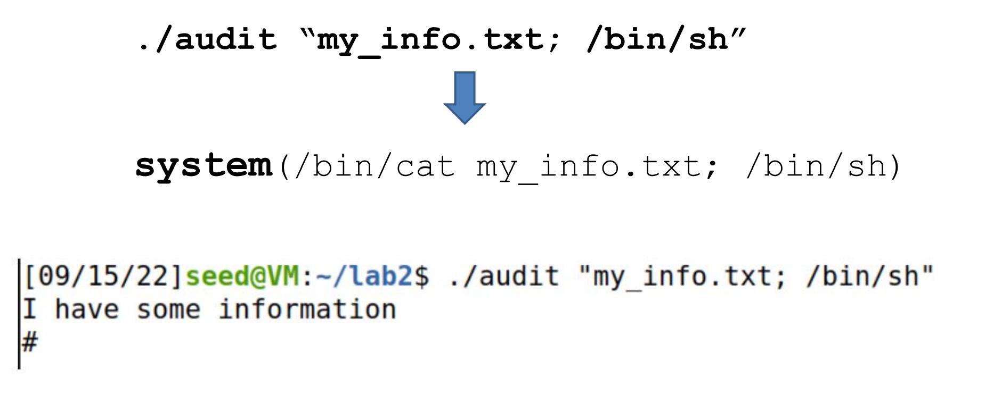
Takeaways
Trust- Trust as little as possible. We never know for sure how a user will interact with software
Intended Design- Users may interact with out system in ways that we did not think of.
Separation- There should always be a clear separation of code and data (user input)

Slide 19






Takeaways
Trust- Trust as little as possible. We never know for sure how a user will interact with software
Intended Design- Users may interact with out system in ways that we did not think of.
Separation- There should always be a clear separation of code and data (user input)
Control Flow Hijack- There should not be any way for an attacker to hijack the “natural flow of things”
Malicious Website
10.9.0.5
Client Container
10.9.0.53
Malicious DNS Server

Slide 20

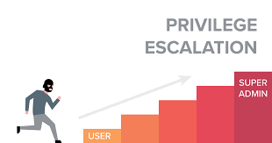
Takeaways
Trust- Trust as little as possible. We never know for sure how a user will interact with software
Intended Design- Users may interact with out system in ways that we did not think of.
Separation- There should always be a clear separation of code and data (user input)
Control Flow Hijack- There should not be any way for an attacker to hijack the “natural flow of things”
Privilege- Privilege is a very powerful mechanism. We should never give more privilege than needed

Slide 21

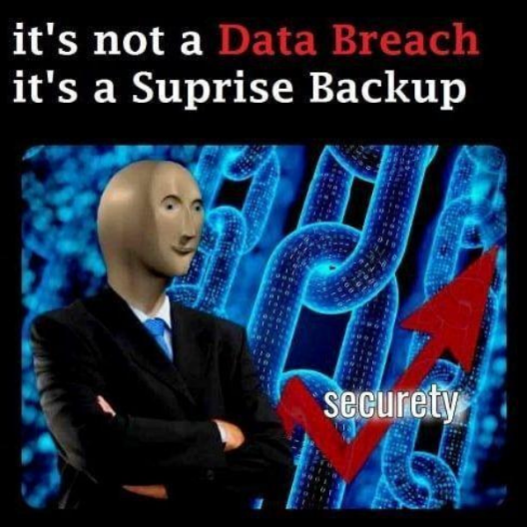

Takeaways
Trust- Trust as little as possible. We never know for sure how a user will interact with software
Intended Design- Users may interact with out system in ways that we did not think of.
Separation- There should always be a clear separation of code and data (user input)
Control Flow Hijack- There should not be any way for an attacker to hijack the “natural flow of things”
Privilege- Privilege is a very powerful mechanism. We should never give more privilege than needed
Usability- Security and software should be useable. Too much security will push people away

Slide 22

Takeaways
Trust- Trust as little as possible. We never know for sure how a user will interact with software
Intended Design- Users may interact with out system in ways that we did not think of.
Separation- There should always be a clear separation of code and data (user input)
Control Flow Hijack- There should not be any way for an attacker to hijack the “natural flow of things”
Privilege- Privilege is a very powerful mechanism. We should never give more privilege than needed
Usability- Security and software should be useable. Too much security will push people away
Layering- Security should be happening at multiple layers
(Firewall → Input Sanitization → Authentication → Antivirus Scanner)
Countermeasures exist, but are they effective? And are they enabled?

Slide 23





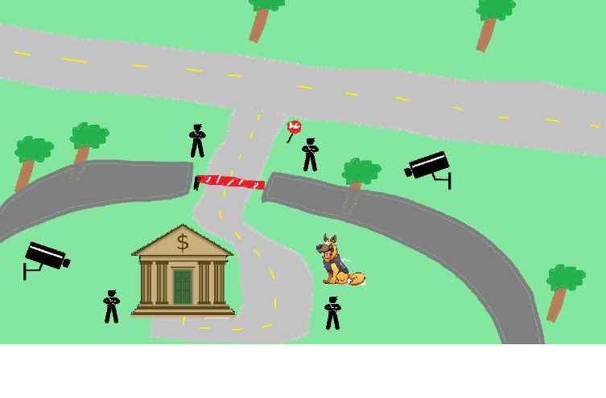

Perfect security is impossible
New assets
New threats
(ZERO days)
New capabilities
New technology

Slide 24
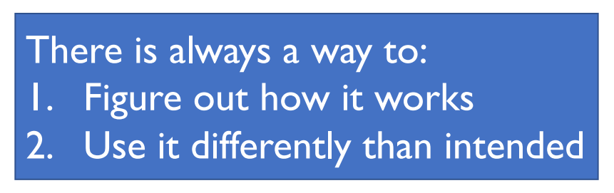
Takeaways

Slide 25
Takeaways
Humans will always be the weakest link.
Social Engineering
Phishing
Writing bad code
Physical Security is also important

Slide 26
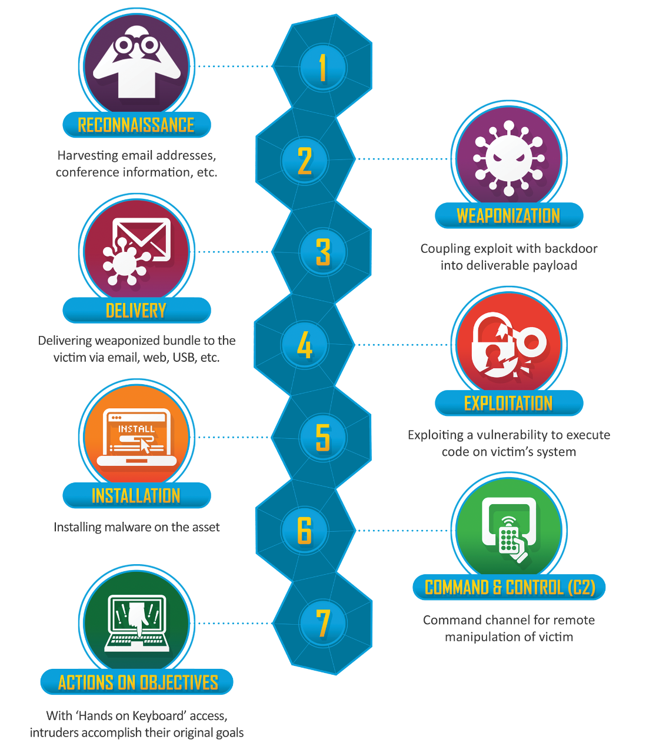
Be aware of the steps taken by a cybercriminal to conduct some cyber attack
“Cyber kill chain”

Slide 27
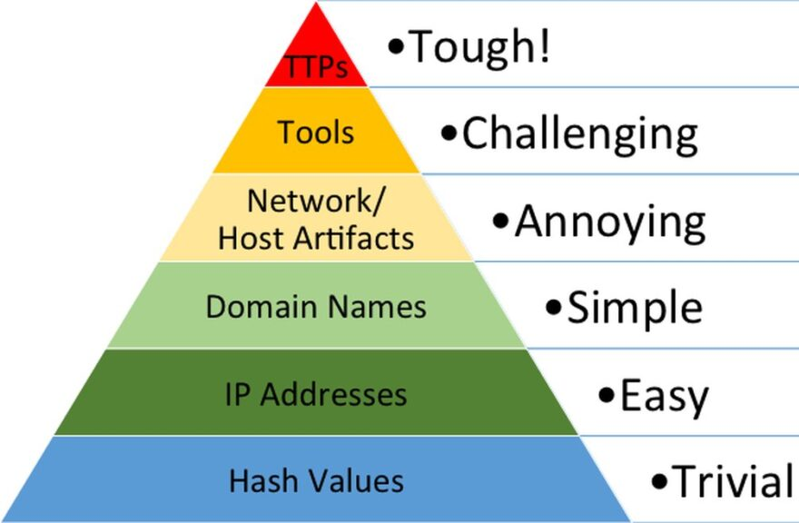
Responding to a threat can have varying levels of difficulty
Indicators of compromise (IOCs) refer to data that indicates a system may have been infiltrated by a cyber threat. They provide cybersecurity teams with crucial knowledge after a data breach or another breach in security.
“Pyramid of Pain”

Slide 28
What’s next?
Cybersecurity Newsletters + Blogs
Dark Readings (https://www.darkreading.com/)
Schneier on Security (https://www.schneier.com/)
The Hacker News (https://thehackernews.com/)
Be aware of new vulnerabilities, new attacks
Cybersecurity Certificate and trainings
CompTIA
Security+
CySa
SANS
ISC2
Have hope
Cybersecurity-related Classes at MSU
CSCI 466 – Networks (reese)
CSCI 460 – Operating Systems (reese)
CSCI 351 – System Administration
CSCI 5XX – Intro to Malware (New Class in F23)

Slide 29

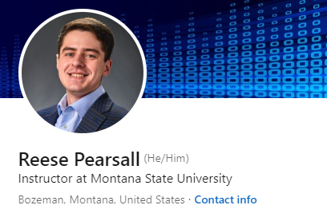

Thank You!
This class has been a blast to teach. Thank you for your patience, flexibility, kindness, and for laughing at my jokes ☺
There were a lot of long nights, and I know things were not perfect, and I had to make some sacrifices
I hope you enjoyed this class, and I hope the stuff you learned will be helpful in your career/future classes
If I can be of assistance to you for anything in the future (reference, advising, support), please let me know!
I will be teaching CSCI 460, 466, and 132 next semester (not confirmed)
Connect with me on LinkedIn! If you find a job in cybersecurity, please keep in touch!
Congrats to those that are graduating next weekend! I hope you find a job that you love!

